Slide 1
AZ-900T01 Module 02: Core Azure services

Slide 2
Lesson 01: Learning objectives

Slide 3
Module 2 – Learning objectives
Understand and describe core Azure:
architectural components.
services and products.
solutions.
management tools.

Slide 4
Lesson 02: Core Azure architectural components

Slide 5
Regions
Azure data centers are located around the globe, and are available to users by country/ region.
A region is a geographical area containing at least one—potentially multiple—data center(s), in close proximity on a low-latency network.
Notes:
A list of regions and their locations is available at : https://azure.microsoft.com/en-us/global-infrastructure/locations/
This slide describes what is meant by "region”, in the context of this course.
Microsoft Azure has more global regions than any other cloud provider.
This gives customers the flexibility and scale they need to bring their applications closer to their users around the world, while preserving data residency. Azure regions offer customers comprehensive compliance and resiliency options. At the time of writing, Azure is available in 42 regions around the world, with plans announced for 12 additional regions.

Slide 6

Regions - continued
Azure special regions
For applications with specific compliance or legal requirements.
Azure Government (North America)
Azure China 21Vianet (Asia)
Azure Germany (Europe)
Region pairs
Each Azure region is paired with another region, within the same geography. Pairing replicates Azure resources to minimize service interruptions from natural disasters, power or network outages.
Notes:
Special Azure regions include:
North America - US DoD Central, US Gov Virginia, US Gov Iowa, and more in the US. These are physical and logical network-isolated instances of Azure for US government agencies and partners. They are operated by screened US personnel, and require strict compliance certifications.
Asia - China East, China North, and more in China. These regions are available through a unique partnership between Microsoft and 21 Vianet. Microsoft does not directly maintain these data centers.
Europe - Germany Central and Germany Northeast. These regions are available through a data trustee model. Customer data remains in Germany, under control of T-Systems (a Deutsche Telekom company).
Additional advantages of region pairs include:
Reduced recovery times - In the event of a wider Azure outage, one region out of every pair is prioritized to minimize application recovery times.
Minimized impact of planned outages - Planned Azure updates are rolled out to paired regions, one region at a time, to minimize downtime and risk of application outage.
Financial and legal compliance - Data continues to reside within the same geography as its pair (except for Brazil South) for tax and law enforcement jurisdiction purposes.
Examples of region pairs are: West US paired with East US, and Southeast Asia paired with East Asia.
For a list of region pairs, see : https://docs.microsoft.com/en-us/azure/best-practices-availability-paired-regions#what-are-paired-regions

Slide 7
Geographies
Discrete markets that preserve data residency and compliance boundaries.
Geography features :
Typically contain two or more regions.
Allow customers with specific data-residency and compliance needs to keep their data and applications in close proximity.
Categorized as Americas, Europe, Asia Pacific, Middle East, and Africa.
Notes:
A list of geography locations is available at : https://azure.microsoft.com/en-us/global-infrastructure/geographies/

Slide 8
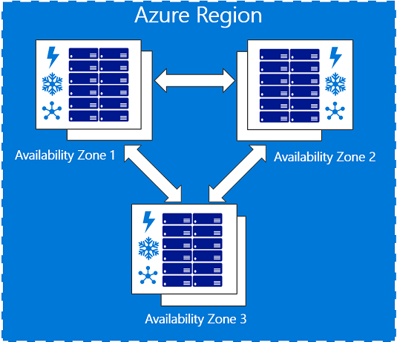
Availability zones
Physically separate locations within an Azure region.
Made up of one or more data centers, equipped with independent power, cooling, and networking.
Act as an isolation boundary.
If one availability zone is down, the other continues working.
Notes:
Availability zones:
Are typically connected to each other through very fast, private fiber optic networks.
Allow customers to run mission-critical applications with high availability and low-latency replication.
Offered as an Azure service.
To ensure resiliency, there’s a minimum of 3 separate zones in all enabled regions.
For details about Azure Availability Zones visit : https://docs.microsoft.com/en-us/azure/availability-zones/az-overview

Slide 9
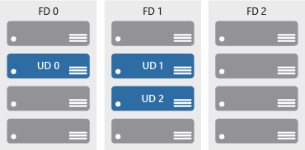
Availability sets
Keep applications online during maintenance or hardware failure.
Comprised of:
Update domains : Scheduled maintenance, performance or security updates are sequenced through update domains.
Fault domains : Provide a physical separation of workloads across different hardware in a data center.

Slide 10
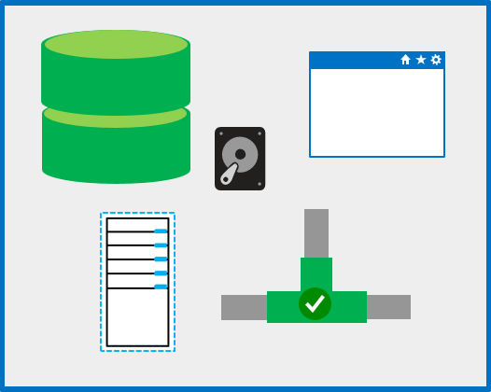
Resource groups
A unit of management for resources in Azure.
Resource group features :
Act as containers to aggregate the resources required by an application into a single, manageable unit.
Every Azure resource must exist in one (and only one) Resource Group.
Notes:
Think of a resource group as a container that allows you to aggregate and manage all the resources required by your application, in a single manageable unit.
Every resource created in Azure must exist in one and only one Resource Group.

Slide 11
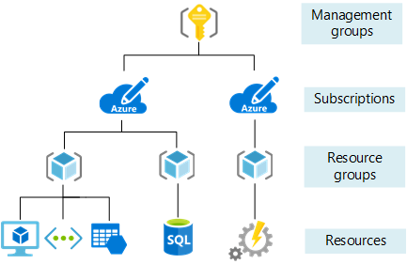
Azure Resource Manager
Provides a management layer to hold resource groups and resources.
Use Azure Resource Manager to:
create, configure, manage, and delete groups.
deploy application resources.
organize resources.
control access and resources.
Notes:
Azure Resource Manager:
provides a consistent management layer that allows you to automate the deployment and configuration of your resources.
accommodates different automation and scripting tools, such as Microsoft Azure PowerShell, Azure Command-Line Interface (Azure CLI), Azure portal, REST API, and client software development kits (SDKs).
For details about Azure Resource Manager, see : https://docs.microsoft.com/en-us/azure/azure-resource-manager/resource-group-overview

Slide 12
Lesson 03: Core Azure services and products

Slide 13
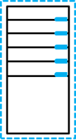
Azure compute services
On-demand computing service for running cloud-based applications.
Azure compute services features :
provides computing resources such as disks, processors, memory, networking, and operating systems.
makes resources available in minutes or seconds.
pay-per-use.
common on-demand Azure services are : (a) Virtual Machines, and (b) Containers.
Notes:
For a list of Azure compute services, and when and where to use them, see : https://azure.microsoft.com/en-us/product-categories/compute/

Slide 14
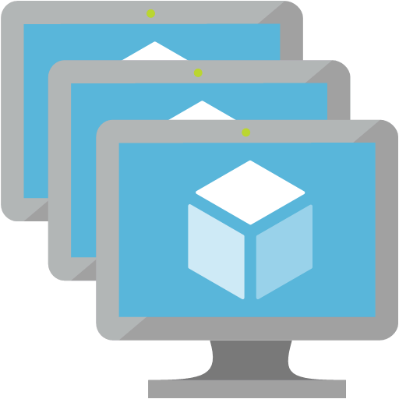
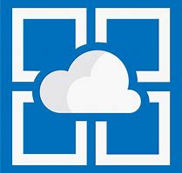

Azure compute services : virtual machines (VMs)
Virtual Machines (VMs) are software emulations of physical computers.
Azure services for VMs include:
Azure VMs : IaaS for creating and using VMs in the cloud.
VM Scale Sets : For the automated scaling of identical VMs.
App services : PaaS for building, deploying, and scaling enterprise-grade apps.
Functions : Create infrastructure based on events.
Notes:
Azure VMs - Lets you create and use VMs in the cloud. It provides Infrastructure as a Service (IaaS) and can be used in various ways. When you need total control over an operating system and environment, Azure VMs are an ideal choice. For details, see : https://azure.microsoft.com/en-us/services/virtual-machines/
VM scale sets - VM scale sets are an Azure compute resource used to deploy and manage sets of identical VMs. With all VMs configured the same, VM scale sets support true auto-scaling, and no pre-provisioning of VMs is required. For details, see : https://azure.microsoft.com/en-us/services/virtual-machine-scale-sets/
App Services - With App Services, you can build, deploy, and scale enterprise-grade web and mobile apps, and APIs to run on any platform quickly. You can meet rigorous performance, scalability, security, and compliance requirements, while using a fully managed platform to perform infrastructure maintenance. App Services is a platform as a service (PaaS) offering. For details, see : https://azure.microsoft.com/en-us/services/app-service/
Functions - When your primary concern is for the code running your service, and not the underlying platform or infrastructure, Azure Functions are ideal. They're commonly used when you need to perform work in response to an event (often via a REST request), a timer, or messages from another Azure service. Use Azure functions for work that can be completed quickly, within seconds or less. For details, see : https://azure.microsoft.com/en-us/services/functions/

Slide 15
Demo: Create an Azure virtual machine

Slide 16
Walkthrough-Create a Virtual machine using Azure Portal
In this walkthrough, you create a Virtual Machine (VM) in Azure via the Azure Portal. You configure the VM as a web server, and connect to the web server over the internet.
Finish this walkthrough by completing the steps that follow, or by reading through them.
Notes:
During or after class, students can read through these walkthrough tasks or complete the actual walkthrough steps [like a lab task]. Students may complete this walkthrough at the end of:
the module, together with all or some of the other walkthroughs from this module [like an end-of-module lab]
the course, together with all or some of the other walkthroughs from the overall course [like an end-of-course lab].
Alternatively, MCTs may step through this walkthrough as a demo for students.

Slide 17
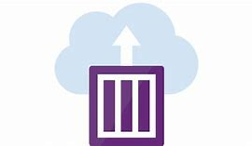
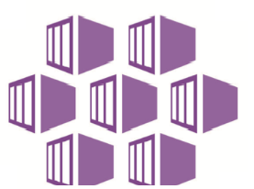
Azure compute services – container services
Containers are a virtualization environment that do not include an operating system. Containers are lightweight, and created, scaled out, and stopped dynamically.
Example Azure services for containers:
Azure Container Instances : Platform as a Service (PaaS) offering for uploading and running containers.
Azure Kubernetes Service : Container orchestrator service for managing large numbers of containers.
Notes:
Azure Container Instances - Offers the fastest and simplest way to run a container in Azure, without having to manage VMs or adopt any additional services. It’s a Platform as a Service (PaaS) offering that allows you to upload your containers, which it then runs for you. For details, see : https://azure.microsoft.com/en-us/services/container-instances/
Azure Kubernetes Service - Automating and managing large numbers of containers and their interactions is called Orchestration. The Azure Kubernetes Service (AKS) is a complete orchestration service for large volumes of containers with distributed architectures. For details, see https://azure.microsoft.com/en-us/services/kubernetes-service/

Slide 18
Walkthrough-Deploy Azure Container Instances (ACI) in Azure Portal
In this walkthrough, you create, configure, and deploy a Docker container to Azure Container Instances (ACI) in Azure Portal. The container is created from an image template called microsoft/aci-helloworld. The image packages a small web application, written in Node.js, and serves a static HTML page.
Finish this walkthrough by completing the steps that follow, or by reading through them.
Notes:
During or after class: Students can read or step through these walkthrough tasks. Complete this walkthrough at the end of the module or the overall course. This walkthrough can be completed together with all or some of the other walkthroughs from this module or from elsewhere in the course.

Slide 19




Azure network services
Connects cloud and on-premises infrastructure and services.
Azure network services include:
Virtual Network : Create virtual, cloud-based networks.
Load Balancer : Distribute workloads over networked resources.
VPN Gateway : Securely connect on-premises networks.
Application Gateway : Front end, application-level routing.
Content Delivery Network (CDN) : Global content delivery and acceleration.
Notes:
Azure Virtual Network - Enables many types of Azure resources, such as Azure VMs, to communicate with each other securely, via the internet or on-premises networks. A virtual network is scoped to a single region. However, multiple virtual networks from different regions can be connected together using virtual network peering. For details, see : https://azure.microsoft.com/en-us/services/virtual-network/
Azure Load Balancer - Provides scale for your applications and adds high availability to your services. For details, see : https://azure.microsoft.com/en-us/services/load-balancer/.
VPN gateway – Also referred to as a virtual network gateway , is a type of virtual network gateway. A VPN gateway provides a secure connection from an on-premises location to Azure, over the internet. It sends encrypted traffic between an Azure Virtual Network and the on-premises network location via the public internet. For details, see : https://azure.microsoft.com/en-us/services/vpn-gateway
Azure Application Gateway - A web traffic load balancer that enables you to manage traffic to your web applications. It is the connection-point into your application for end users. For details, see : https://azure.microsoft.com/en-us/services/application-gateway/
Content Delivery Network (CDN) - A distributed network of servers that can deliver web content to users efficiently. It delivers content to users in their local region, to minimize latency. A CDN can be hosted in Azure or any other location. For details, see : https://azure.microsoft.com/en-us/services/cdn/
For a list of Azure networking services, and when and where to use them, see : https://azure.microsoft.com/en-us/product-categories/networking/

Slide 20
Walkthrough-Create a virtual network via the Azure Portal
In this walkthrough you create a Virtual Network. You deploy two virtual machines (VMs) onto the virtual network, and configure the VMs to allow one to ping the other over the virtual network.
Finish this walkthrough task by completing the steps that follow, or by reading through them.
Notes:
During or after class: Students can read or step through these walkthrough tasks. Complete this walkthrough at the end of the module or the overall course. This walkthrough can be completed together with all or some of the other walkthroughs from this module or from elsewhere in the course.

Slide 21
Azure storage services – data categories
Structured data | Semi-structured data | Unstructured data
Adhere to a schema, with same data fields or properties. | Ad hoc schema. Less organized fields and properties than structured data. | No designated schema or data structure.
Storable in relational database tables, with rows and columns. | Non-relational or NoSQL data, not storable in tables, rows and columns. | Non-relational or blob data, with no restrictions on kinds of data blobs contain.
Examples include, sensor or financial data. | Books, blogs, and HTML documents are examples of semi-structured data. | For example, a blob can hold a PDF, JPG, JSON object, or video.
Notes:
This slide intends to:
help students understand how data are structured and classified
explain why different storage services exist
illustrate how storage services are used
map data structures to corresponding storage services

Slide 22

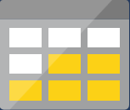

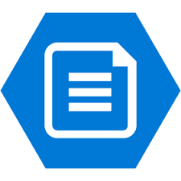
Azure storage services – Azure services
Store files, messages, tables, and other types of information.
Azure Storage services include:
Blob storage : No restrictions on the kinds of data blobs can hold. Blobs are highly scalable.
Disk storage : Provides disks for virtual machines, applications, and other services.
File storage : Fully-managed file shares in the cloud.
Archive storage : Store rarely accessed data.
Notes:
Blob Storage - Azure Blob Storage is unstructured, meaning there are no restrictions on the kinds of data it can hold. Blobs are highly scalable, and apps work with blobs in the same way they work with files on a disk (such as reading and writing data). Blob Storage can manage thousands of simultaneous uploads, massive amounts of video data, constantly growing log files, and can be reached from anywhere with an internet connection. For details, see : https://azure.microsoft.com/en-us/services/storage/blobs/
Disk storage - Provides disks for virtual machines, applications, and other services to access and use as needed. Similar to using on-premises/ local disks. For details about Managed Disks pricing, see : See https://azure.microsoft.com/en-us/services/storage/disks/
File storage – Azure offers fully managed file shares in the cloud, accessible via the industry standard Server Message Block (SMB) protocol. For details, see : https://azure.microsoft.com/en-us/services/storage/files/
Archive storage - Provides storage facilities for data that is accessed less frequently or rarely. Archive legacy data in Azure at lower costs than archives traditionally cost to create and maintain. For details, see : https://azure.microsoft.com/en-us/services/storage/archive/

Slide 23
Demo: Create Blob storage

Slide 24
Walkthrough-Create Blob storage
In this walkthrough you create a Storage Account, and make a Blob Storage container within the storage account. You upload a block blob, view and edit the blob file, within the blob container, in Azure. Then, you download the block blob file.
Finish this walkthrough task by completing the steps that follow, or by reading through them.
Notes:
During or after class: Students can read or step through these walkthrough tasks. Complete this walkthrough at the end of the module or the overall course. This walkthrough can be completed together with all or some of the other walkthroughs from this module or from elsewhere in the course.

Slide 25

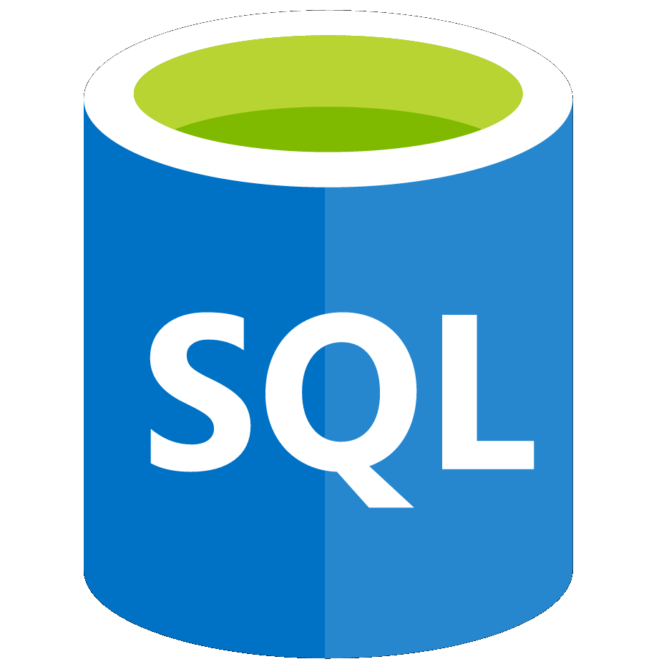
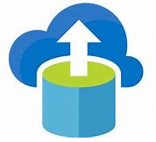
Azure database services
Fully-managed, Platform as a Service (PaaS) solution for databases.
Examples of Azure database services:
Azure Cosmos DB : Globally-distributed database service for scaling throughput and storage, elastically and independently.
Azure SQL Database : Relational Database as a Service (DaaS) based on the latest Microsoft SQL Server database engine.
Azure Database Migration : Migrate from multiple database sources to Azure data platforms with minimal downtime.
Notes:
Azure Cosmos DB - A globally distributed database service that enables you to scale throughput and storage across any number of Azure's geographic regions, elastically and independently. For details, see : https://azure.microsoft.com/en-us/services/cosmos-db/
Azure SQL Database - A relational Database as a Service (DaaS) based on the latest stable version of the Microsoft SQL Server database engine. SQL Database is a high-performance, reliable, fully managed and secure database. For details, see : https://azure.microsoft.com/en-us/services/sql-database/
Azure Database Migration Service - A fully managed service designed to enable seamless migrations from multiple database sources to Azure data platforms, with minimal downtime (supports online migrations). For details, see : https://azure.microsoft.com/en-us/services/database-migration/
For a list of Azure data services, and when and where you use them, see : https://azure.microsoft.com/en-us/product-categories/databases/

Slide 26
Walkthrough-Create a SQL database
In this walkthrough you create a SQL Database in Azure, then query the data in the database.
Finish this walkthrough task by completing the steps that follow, or by reading through them.
Notes:
During or after class: Students can read or step through these walkthrough tasks. Complete this walkthrough at the end of the module or the overall course. This walkthrough can be completed together with all or some of the other walkthroughs from this module or from elsewhere in the course.

Slide 27
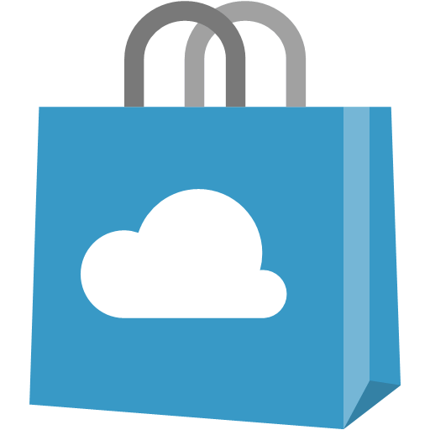
Azure Marketplace
Connects end users with Microsoft partners, Independent Software Vendors (ISVs), and start-ups that offer solutions and services for Azure.
Azure customers, IT professionals and cloud developers can find, try, purchase, and provision Azure applications and services from certified service providers.
Includes close to 10,000 product listings.
Notes:
The Azure Marketplace FAQs are available at : https://azure.microsoft.com/en-us/marketplace/faq/
Consider asking students to visit Azure Marketplace services online at : https://azuremarketplace.microsoft.com/en-us/ or to access it via Azure Portal.

Slide 28
Lesson 04: Azure solutions

Slide 29

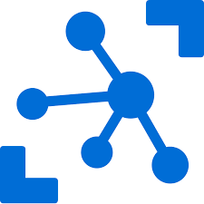
Internet of Things (IoT)
Send and collect information for data analysis from internet-ready devices.
Azure IoT services include:
Microsoft IoT Central : Fully-managed, Software as a Service (SaaS) solution to connect, monitor, and manage IoT assets.
Azure IoT Hub : Managed, cloud-hosted, central message hub for bidirectional communication between IoT applications and devices.
Notes:
Microsoft IoT Central - A fully managed, global, Internet of Things (IoT), Software as a Service (SaaS) solution that makes it easy to connect, monitor, and manage your IoT assets at scale. No cloud expertise is required to use IoT Central. As a result, you can bring your connected products to market faster while staying focused on your customers. For details, see : https://docs.microsoft.com/en-us/azure/iot-central/
Azure IoT Hub - A managed service, hosted in the cloud, that acts as a central message hub for bi-directional communication between your IoT application and the devices it manages. You can use Azure IoT Hub to build IoT solutions with reliable and secure communications between millions of IoT devices and a cloud-hosted solution backend. You can connect virtually any device to your IoT Hub. For details, see : https://docs.microsoft.com/en-us/azure/iot-hub/
For a list of Azure IoT-related services, and where and when to use them, see : https://azure.microsoft.com/en-us/overview/iot/

Slide 30
Walkthrough-Add IoT device to Azure IoT Hub
In this walkthrough, you set up a new Azure IoT Hub in Azure Portal. You configure the hub to authenticate a connection to an IoT device, using the online Raspberry Pi device simulator. Sensor data and messages are passed from the Raspberry Pi simulator to your Azure IoT Hub. You view metrics for the messaging activity in Azure Portal.
Finish this walkthrough task by completing the steps that follow, or by reading through them.
Notes:
During or after class: Students can read or step through these walkthrough tasks. Complete this walkthrough at the end of the module or the overall course. This walkthrough can be completed together with all or some of the other walkthroughs from this module or from elsewhere in the course.

Slide 31
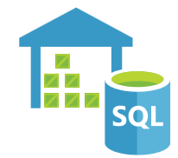


Big data and analytics
Make sense of, and decisions about, large collections of complex data.
Azure big data and analytic services include:
Azure SQL Data Warehouse : Cloud-based, enterprise data warehouse that queries petabytes of data quickly using Massively Parallel Processing (MPP).
Azure HDInsight : Fully-managed, open-source, analytics service for an easy, fast and cost-effective way to process massive amounts of data in the cloud.
Azure Data Lake Analytics : On-demand, analytics job service that simplifies big data. Users write queries to transform their data and extract valuable insights.
Notes:
Azure SQL Data Warehouse - A cloud-based, enterprise, data warehouse that leverages Massively Parallel Processing (MPP), to run complex queries quickly and across petabytes of data. For details, see : https://azure.microsoft.com/en-us/services/sql-data-warehouse/
Azure HDInsight - A fully managed, open-source analytics service for enterprises. It’s a cloud service that makes it easier, faster, and more cost-effective to process massive amounts of data. It supports popular open-source frameworks and cluster types, such as Apache Spark, Hadoop, Kafka, HBase, and Storm, and Machine Learning Services. For details, see : https://azure.microsoft.com/en-us/services/hdinsight/
Azure Data Lake Analytics - An on-demand analytics job service that simplifies big data. Instead of deploying, configuring, and tuning hardware, you write queries to transform your data and extract valuable insights. For details, see : https://azure.microsoft.com/en-us/services/data-lake-analytics/
For a list of Azure Big Data and Analytics services, and when and where you use them, see : https://azure.microsoft.com/en-us/product-categories/analytics/

Slide 32


Artificial Intelligence (AI)
A range of applications, including Machine Learning, which use existing data to forecast future behaviors, outcomes, and trends.
Azure AI services include:
Azure Machine Learning service: Provides a cloud-based environment for developing, training, testing, deploying, managing, and tracking machine learning models.
Azure Machine Learning Studio: A collaborative, drag-and-drop visual workspace where you can build, test, and deploy machine learning solutions without writing code.
Notes:
Azure Machine Learning Service - Provides a cloud-based environment you can use to develop, train, test, deploy, manage, and track your machine learning models. It can auto-generate a model and auto-tune it for you. It will let you start training on your local machine, and then scale out to the cloud. When you have the right model, you can easily deploy it to Azure in a container such as Docker. For details, see : https://azure.microsoft.com/en-us/services/machine-learning-service/
Azure Machine Learning Studio - A collaborative, drag-and-drop visual workspace where you can build, test, and deploy machine learning solutions without the need to write code. It uses pre-built and pre-configured machine learning algorithms and data-handling modules. Use Machine Learning Studio when you want to experiment with machine learning models quickly and easily, if the built-in machine learning algorithms are sufficient for your solutions. It provides less control over machine learning algorithms than the Azure Machine Learning Service. For details, see : https://azure.microsoft.com/en-us/services/machine-learning-studio/
For a list of Azure AI and Machine Learning services, see the AI + Machine Learning section at : https://azure.microsoft.com/en-us/overview/ai-platform/

Slide 33
Serverless computing
Cloud-hosted execution environment that runs code, but abstracts the underlying hosting environment.
Serverless computing services in Azure include:
Azure Functions : Create infrastructure based on events from the code used to run your services.
Azure Logic Apps : Automate and orchestrate tasks, business processes, and workflows, by integrating apps, data, systems, and services across enterprises or organizations.
Azure Event Grid : Fully-managed, intelligent, event routing service that uses a publish-subscribe model for uniform event consumption.
Notes:
Azure Functions - Ideal when you're only concerned with the code running your service and not the underlying platform or infrastructure. Azure Functions are commonly used when you need to perform work in response to an event—often via a REST request, timer, or message from another Azure service—and when that work can be completed quickly, within seconds or less. For details, see : https://docs.microsoft.com/en-us/azure/azure-functions/
Azure Logic Apps - A cloud service that helps you automate and orchestrate tasks, business processes, and workflows when you need to integrate apps, data, systems, and services across enterprises or organizations. Logic Apps simplify how you design and build scalable solutions. For details, see : https://docs.microsoft.com/en-us/azure/logic-apps/
Azure Event Grid - Allows you to build applications with event-based architectures easily. It's a fully-managed, intelligent event routing service that uses a publish-subscribe model for uniform event consumption. For details, see : https://docs.microsoft.com/en-us/azure/event-grid/
For details about Azure serverless services, see : https://azure.microsoft.com/en-us/solutions/serverless/

Slide 34
Walkthrough-Run serverless code with Azure Functions in Azure portal
In this walkthrough, you write and run serverless code inside an Azure Function App in Azure portal.
Finish this walkthrough task by completing the steps that follow, or by reading through them.
Notes:
During or after class: Students can read or step through these walkthrough tasks. Complete this walkthrough at the end of the module or the overall course. This walkthrough can be completed together with all or some of the other walkthroughs from this module or from elsewhere in the course.

Slide 35

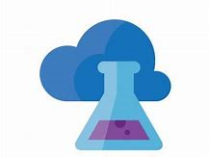
DevOps
Create build and release pipelines that provide continuous integration, delivery, and deployment for applications.
Azure DevOps includes:
Azure DevOps services : Collaborative development tools including Pipelines, Git repositories, Kanban boards, and automated and cloud-based load testing.
Azure DevTest Labs : Create environments in Azure quickly, while minimizing waste and controlling costs.
Notes:
Azure DevOps Services - Formerly known as Visual Studio Team Services (VSTS), provides collaborative development tools including: high-performance pipelines; free private Git repositories; configurable Kanban boards; extensive automated and cloud-based load testing. For details, see : https://docs.microsoft.com/en-us/azure/devops/
Azure DevTest Labs - A service that helps developers and testers create environments in Azure quickly, while minimizing waste and controlling costs. Users can test their latest application versions by provisioning Windows and Linux environments quickly, with reusable templates and artefacts. For details, see : https://azure.microsoft.com/en-us/services/devtest-lab/
For details about Azure DevOps services, see : https://docs.microsoft.com/en-us/azure/#pivot=products&panel=devops

Slide 36
Lesson 05: Azure management solutions

Slide 37
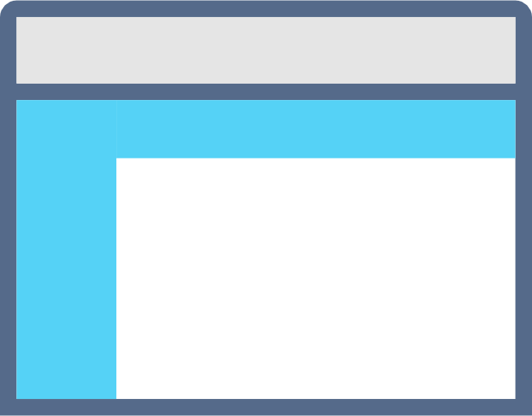
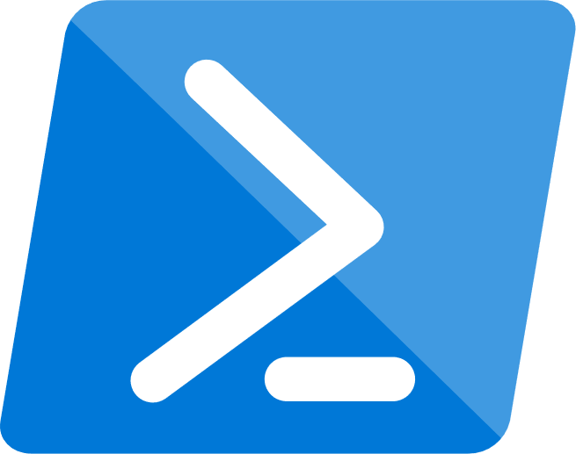

Azure management tools
Configure and manage Azure using a broad range of tools and platforms.
Azure management tools include:
Azure Portal : Management website accessed via a web browser.
Azure PowerShell : Command shell scripting language.
Azure Command-Line Interface (CLI) : Cross-platform, command-line scripting program for Windows, Linux, or MacOS.
Azure Cloud Shell : Browser-based scripting environment.
Notes:
You may provide more detail using the information below. If you’ve time, consider showing students the tools and the URLs for accessing them (where applicable).
Azure Portal - https://portal.azure.com
Azure PowerShell - A module added to Windows PowerShell or PowerShell Core for connecting to your Azure subscription and managing Azure resources.
Azure CLI - A cross-platform, command-line program that connects to Azure and executes administrative commands on Azure resources.
Azure Cloud Shell - A browser-based scripting environment in Azure portal. It provides flexibility by allowing you to choose your preferred shell experience. Linux users can opt for a Bash experience, and Windows users can opt for PowerShell. Access Azure Cloud Shell from : https://shell.azure.com/
You can also use Azure SDKs, in a range of languages, and REST APIs to configure Azure. For a list Azure management tools, see : https://azure.microsoft.com/en-us/downloads/

Slide 38
Demo: Customize the Azure Portal

Slide 39
Walkthrough-Working with the Azure CLI
In this walkthrough, you install the Azure Command Line Interface (CLI) on your local machine. You create a virtual machine using the Azure CLI and an Azure Resource Manager template. Then, you verify the deployment with the Azure CLI in Azure Cloud Shell.
Finish this walkthrough by completing the steps that follow outlined, or by reading through them.
Notes:
During or after class: Students can read or step through these walkthrough tasks. Complete this walkthrough at the end of the module or the overall course. This walkthrough can be completed together with all or some of the other walkthroughs from this module or from elsewhere in the course.

Slide 40
Walkthrough-Create VMs from a script with Azure PowerShell
In this walkthrough, you write and run a local PowerShell script. The PowerShell script uses the Azure PowerShell module to create three virtual machines in Azure, from a Linux Ubuntu image.
Finish this walkthrough by completing the steps that follow outlined, or by reading through them.
Notes:
During or after class: Students can read or step through these walkthrough tasks. Complete this walkthrough at the end of the module or the overall course. This walkthrough can be completed together with all or some of the other walkthroughs from this module or from elsewhere in the course.

Slide 41
Walkthrough-Install IIS webserver on a VM with Azure Cloud Shell
In this walkthrough, you use Azure Cloud Shell to automate the installation of the Windows Internet Information Services web server (IIS) on a new virtual machine. Azure Cloud Shell creates a virtual machine and uses the Custom Script Extension to install IIS.
Finish this walkthrough by completing the steps that follow outlined, or by reading through them.
Notes:
During or after class: Students can read or step through these walkthrough tasks. Complete this walkthrough at the end of the module or the overall course. This walkthrough can be completed together with all or some of the other walkthroughs from this module or from elsewhere in the course.

Slide 42

Azure Advisor
Analyzes your deployed Azure resources and recommends ways to improve availability, security, performance, and costs.
With Azure Advisor, you can:
Get proactive, actionable, and personalized best practice recommendations.
Improve the performance, security, and availability of your resources.
Identify opportunities to reduce your Azure costs.
Notes:
Azure Advisor is accessible through Azure portal. After you sign into Azure portal, either (a) select Advisor from the navigation menu, or (b) search for Advisor in the All services menu.
You can download recommendations from Azure Advisor in PDF or CSV format, which you can then share.
For details about Azure Advisor, see : https://docs.microsoft.com/en-us/azure/advisor/

Slide 43
Walkthrough-Save a recommendations report with Azure Advisor
In this walkthrough, you create and save a personalized recommendations report with Azure Advisor. You deploy a virtual machine (VM) and network resources, which Azure Advisor analyzes, to provide recommendations and generate the report.
Finish this walkthrough by completing the steps that follow, or by reading through them.
Notes:
During or after class: Students can read or step through these walkthrough tasks. Complete this walkthrough at the end of the module or the overall course. This walkthrough can be completed together with all or some of the other walkthroughs from this module or from elsewhere in the course.

Slide 44
Lesson 06: Module 2 review questions

Slide 45
Module 2 review questions
What are the core architectural components of Azure?
Every resource created in Azure must exist in one and only one what?
You need to deploy a legacy application in Azure. The application needs customizations to ensure it runs successfully. The application will run on a virtual machine with the Windows operating system.
Which Azure service do you recommend running the virtual machine in?
Notes:
Question 1 answer: Region, Geography, Availability Zone, Availability Set, Resource Group, and Azure Resource Manager are core architectural components of Azure.
Question 2 answer: Resource Group is the correct answer. Each resource must exist in one, and only one, resource group.
Question 3 answer: Azure Virtual Machines (VMs) is the correct answer, because Azure VMs provides Infrastructure as a Service (IaaS). This means you’re responsible for configuring and managing the VM(s) that your application runs on. As a result, you can customize the VM to suit your own needs.

